Slide 1

Popularity Prediction of Facenook Videos for Higher Quality Stream
为获得更高质量的视频流，对Facebook上
视频的受欢迎度进行预测

Slide 2
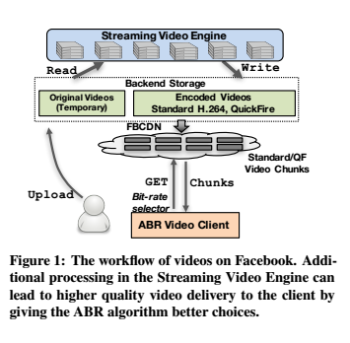
背景介绍
视频流程
1.用户上传的视频会压缩（H.264）为不同大小（不同质量）的版本；
2.客户端根据ABR算法请求相应的视频数据
ABR（adaptive bitrate）:根据当前链接情况，在保证不中断的前提下选最高质量的视频版本

Slide 3
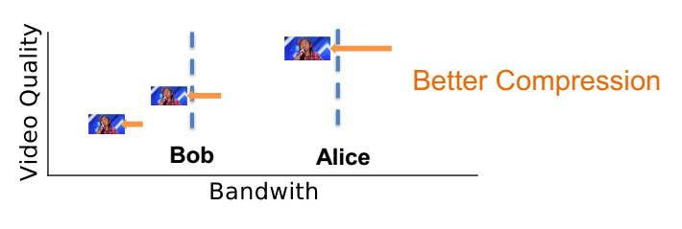
背景介绍
观点1：增加计算量，可提高用户体验
方法1：增加计算，更多版本
250Kbps 1Mbps ，之间的用户对应250Kbps
250Kbps 500Kbps 1Mbps ，（500，1000）之间用户对应 500Kbps
方法2：增加计算，进一步压缩（质量不变）

Slide 4
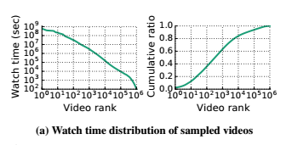
背景介绍
tens of millions of videos uploaded each day;
QuickFire:20% size reduction using 20* computation
several tens the scale of the already
large processing fleet
观点2：计算量增加有限制
观点3：受欢迎程度不均
受欢迎的小部分视频贡献了大部分的观看时间

Slide 5
背景介绍
观点1：增加计算提升服务
观点2：增加受限
观点3：少数视频贡献大部分观看时间
结论：
在视频上传时对其受欢迎程度进行预测，评分高的进行额外计算，从而提升大部分观看时间的视频质量

Slide 6
预测方法比较
1.先进算法：
准确，但无法应对Facebook如此大规模的场景
0（n）存储容量 n:past requests ；
SEISMIC-CF
2.启发式算法：
存储容量小，单不准确；
Owner-Likes

Slide 7
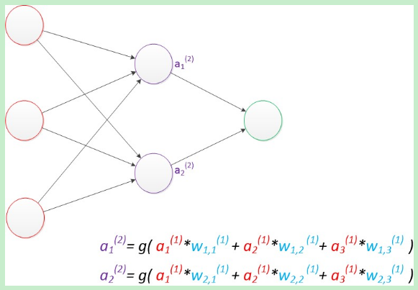
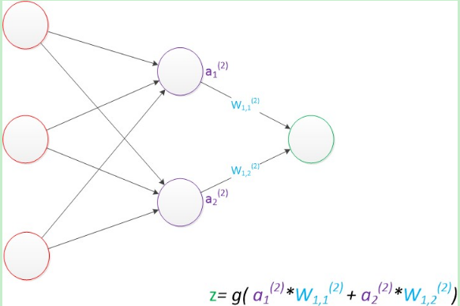
Neural Network
神经网络本质：
通过参数拟合特征与目标之间的函数关系（线性拟合）
模型训练的目地：
使得参数尽可能的与真实的模型逼近
训练方法：
先随机生成参数值，预测训练数据中的样本。样本的预测目标为yp，真实目标为y。那么，定义一个值loss = (yp - y)2称之为损失（loss），我们的目标就是使对所有训练数据的损失和尽可能的小。

Slide 8
CHESS
CHESS--Constant History，Exponential kernals，and Social Signals
算法关键： 1.对之前的访问建模
2.考虑其他特征
3.利用近期访问数据，训练神经网络模型
可扩展的: 视频状态常量数据表示,仅需20GB应对Facebook 负载
准确的：观看时间近似为指数衰减曲线，神经网络模型进行拟合；结合社交网络数据进行优化
快速的

Slide 9

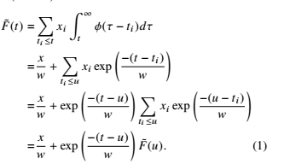
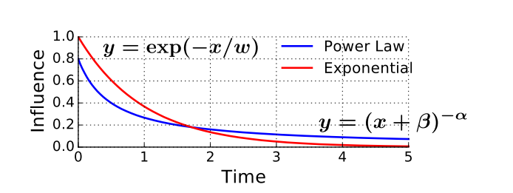
CHESS Algorithm
Model past access influence(EDWT)
efficiently computably,but not accurate enough!

Slide 10
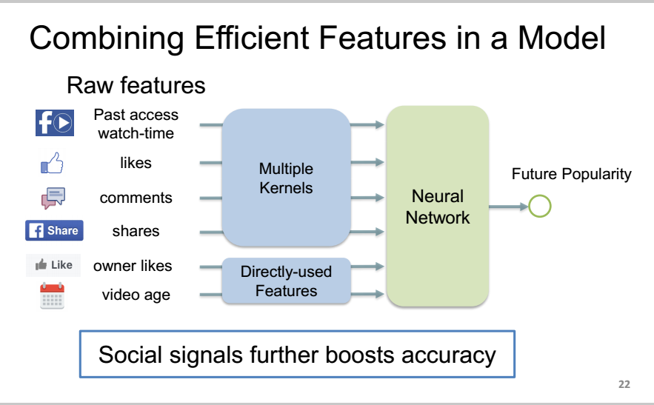
CHESS Algorithm
the 2-layer NN with100 hidden nodes
Stateful
Stateless

Slide 11
CHESS Algorithm
Online Model Update
training examples：
full future watch time is unknown;
use an example queue to approximate
when accessed:into the queue;evicted:become a training data
two parameters to minimize the memory and CPU overhead:
prediction herizion、example distance

Slide 12
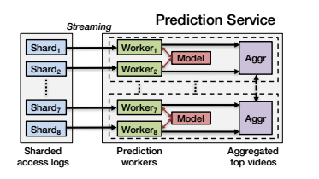
CHESSVPS Implementation
1.Ingesting Access Logs
2.Queryin for Additional Features
3.Making and Serving Predictions
4.Updating the Model
3.enery 10 minutes,workers sort the his 10 million videos,
then an aggregator sorts the top 1 million and broadcasts.
Once an aggregator has the top 1 million predictions from all 8 workers ,it merges and sorts them,the result is used for services in the next 10 minutes.
4. Each video has 12 stateless and 7 stateful features,.~44GB in total

Slide 13
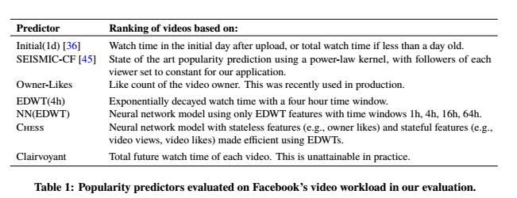
Evaluation
Predictors

Slide 14
Evalution
Experimental Methods and Workload
Single
prediction
Real-time Sampled processing
Simulation
t
the full Facebook video workload
,
a week to warm up and presents the results the next day
a 35-day trace of video access,comprised of a random sample of 1%of videos during 5 weeks
set a time point
the same trace,using the whole trace to trace our model,
23+12

Slide 15
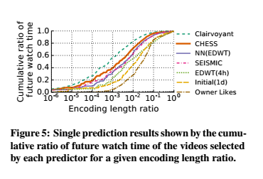
Evalustion
Single Prediction
二次编码视频收看时间占比
Conclusion:
NN(EDWT) is competitive with SEISMIC-CF;
CHESS provides higher accuracy(40% coverage with 2.0* fewer minutes of video than SEISMIC-CF)
二次编码的视频在总视频长度中的占比，代表CPU开销

Slide 16
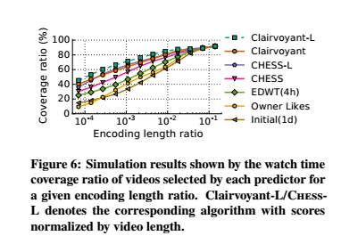
Evalution
Simulation Experiments
Conclusion:
CHESS provides higher accuracy( et. 80% coverage,CHESS-L 2* as many as Clairvoyant-L，while Owner-Likes 8*)

Slide 17
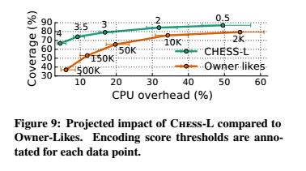
Evaluation
Real-time Sampled Prediction
score threshold
Q:QuickFire encoding time
U:FFmpeg time
N:re-encoded numer
M:daily uploads number
QN/(UM)
Conclution:
~80% coverage,CHESS-L(2):17% ,Owner-Likes(10K):54%
Owner-Likes(500K):37% coverage with 6% CPU overhead;
CHESS-L(4):66.7% coverage with 4.5% CPU overhead

Slide 18
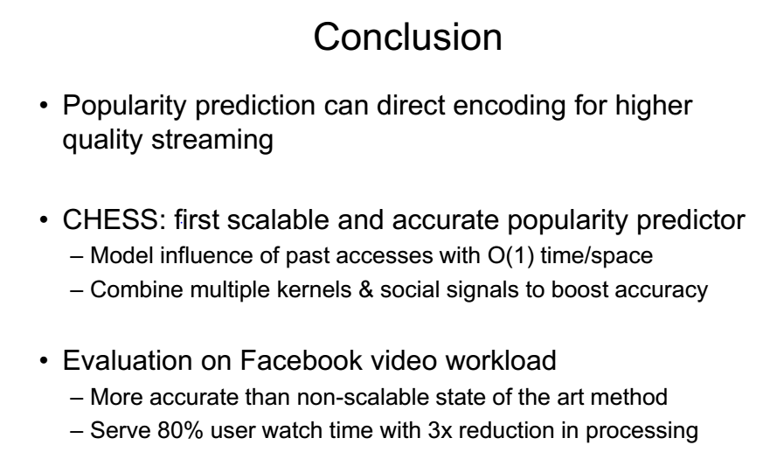
Conclusion

Slide 19
Thank You !

